Slide 1

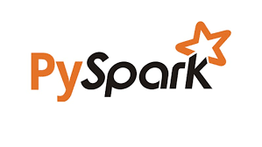
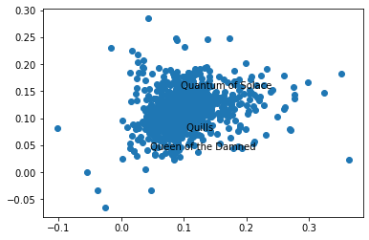
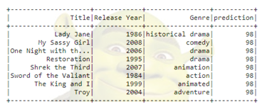
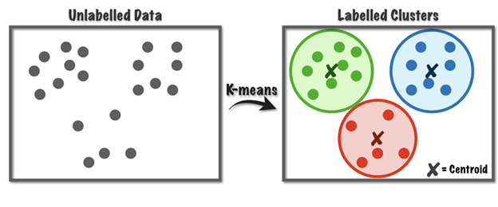
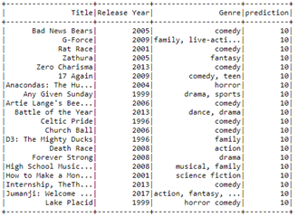
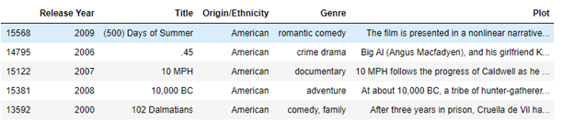
Movie Plot Based Recommender System
Eyoel Armede, Andrew Cummings, Brad Fetes, Ian Ustanik
IST 664 Final Poster Presentation
Project Rationale
Feature Selection
Model 2 (TF-IDF)
Model 3 (Recommender System
Traditional recommender systems use a mix of ratings systems and clustering based on movies watched and similar movie genres or length.
Our goal is to create an addition to these recommender systems by using NLP techniques that match users with relevant movies based on processing the plots of movies they have seen.
Recommending movies based on the content of a film’s plot will not only recommend movies that are similar to a user’s likes and interests (what current recommenders do) but also expand their interest across genres and types of movies they may typically watch.
The features selected are the text of the plot summary only.
We analyzed the sentiments of each sentence in the plot and created an average sentiment value of the movies based on the plot and used negative, positive, neutral, and compound sentiment values from VADER sentiment analyzer as part of our feature sets.
The most common words were used as feature sets as well by removing stop words and names.
The most common verbs, adverbs, adjectives were used as feature sets as well after removing stop words.
Words common to all documents get discounted by the inverse of their frequency:
𝑓𝑖 is number of documents that contain word 𝑖
Generated sentiment of each movie plot using NLTK VADER applied on each sentence, with the average of all the sentences returned.
Used a PySpark machine learning pipeline:
Tokenizer()
StopWordsRemover()
CountVectorizer()
IDF()
VectorAssembler()
StandardScaler()
Kmeans()
Produced K-means clusters, where k=100 distinct clusters.
Few very large clusters where there was too little plot data and therefore insufficient distinction amongst individual movies.
Few very small clusters that appeared to be outliers.
Returned ~ 40 very strong candidates for good clusters which generated interesting insights and results that could be used to make a movie recommendation.
This method uses word embedding and filtration to create vectors for each movie, a well-known algorithm used by companies such as Netflix.
Recommender System using Words2Vector Pipeline:
Tokenizer()
StopWordRemover()
Word2Vec()
VectorAssembler()
Kmeans()
This method is useful because of its high interpretability: features are in 3 dimensions, but also limited for clusters because the splits can be arbitrary.
Data Description
Model 1 (Most Common Words)
The datasets we are using for our analysis are from Kaggle.
The information in these datasets come from one of two sources, IMDB or Wikipedia.
Each dataset includes the title of the film, release year, plot summary, and a genre categorization.
Two of the datasets add additional elements such as name of the director, prominent actors/actresses, Wikipedia page, and origin of the film.
Combined, filtered dataset contained ~ 90,000 movie records.
The team decided to only analyze movies that were released >= 1980.
One option for a recommendation engine based on movie plots would be to create features based on the most common words in the corpus.
Our corpus contained over 60,000 words and this model utilized the top 2% of words in the corpus to look for relationships between movie plots.
There are a few downsides to this potential model. First, by basing the features on the most popular words in the whole corpus, movies with unique plots may be left empty or without any defining features.
Relatedly, picking the appropriate number of words to base features on is important. If too few word features are picked, distinctions between movies will be difficult but having too many words as features may render some clusters with only one or two films.
Lastly, the difference in the lengths of the movie’s plots is going to be a concern using this method. For example, Legally Blonde has 147 terms in which to cluster around, while the 1987 film Cyclone only has seven.
Features: In model 1, the most common words were used as features, this contrasts our second model, the tf-idf model because tf-idf penalizes weights for most common words, while our third model has filtered words being embedded and compared directly without penalizing number of instances.
Outcomes of each model: overall, each model contained 100 clusters, with all three models having one larger cluster and many smaller clusters that contained outlier movies.
Comparison
Pre-Processing Steps
The data is selected from 3 different resources as such the data set has been filtered and merged.
All Features aren’t available across all the 3 sources as such the necessary features were plot summary, title and release year .
The datasets were combined in such a way that if the movie is available across all the data sets then the entry with the longest plot summary is taken as an entry.
The data set was filtered based on origin as well only taking American and British movies.
Interpretation
We wanted to utilize the plot to find movie recommendations that bypassed feature-heavy traditional genre, user review-based models.
Our models achieved what we wanted to achieve, groups of non-traditional clusters that recommend movies that on the surface do not appear to be related.
Our models also matched movies that one would expect to see together, showing their versatility and usability in a combined commercial recommender system.
Reference
https://www.kaggle.com/mananjhaveri/imdb-movies-data/tasks?taskId=2170
https://www.kaggle.com/jrobischon/wikipedia-movie-plots
https://www.kaggle.com/cryptexcode/mpst-movie-plot-synopses-with-tags

